Slide 1
Big Mountain Resort
Ticket Price Analysis

Slide 2
Problem Identification
reduce the operating cost of 1540,000 without undermining the ticket price
select the better value for their ticket price as they have been underpricing their ticket price .

Slide 3
Recommendation and Key Findings
Resort should increase the price of ticket and make it around 89 to 90 dollar.
They should get rid of least used run as it will help to reduce the operating cost.
They should increase the vertical drop by adding a run to a point 150 feet lower down

Slide 4
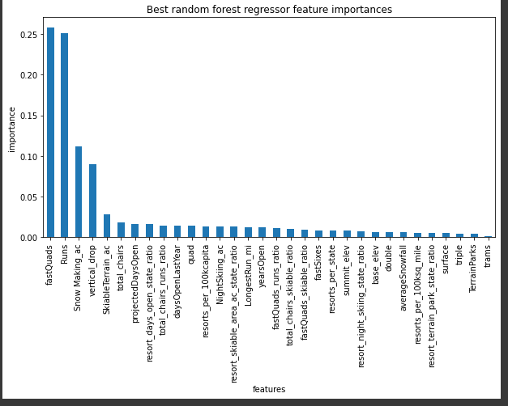
Modeling Results:
Important Features for ticket Price analysis : (Random Forest Model)
Fast Quads
Runs
Snow making
Vertical Drop

Slide 5
Ticket Price
The modeled price is 94.22 with the mean absolute error of 10.39,
This suggests that there is room for an increase for the ticket price.

Slide 6
Increasing Vertical Drop
Vertical is an important feature that helps to determine the ticket price
Increase the vertical drop adding a run to a point 150 feet lower down but requiring the installation of an additional chair lift . This will increase the revenue of the resort.

Slide 7
Runs:
Closing More than 1 run could negatively impact the ticket price .
Closing 2-3 runs will cause sharp decrease in revenue .
Closing 4 to 5 runs makes no difference than closing 3 run

Slide 8
Conclusion
By doing all the data analysis and using random forest model to predict the ticket price , we came to the conclusion that the resort should increase the ticket price to 90- 91 dollars.
Closing 1 run will not affect the ticket price but helps to reduce the operating cost.
Increase the vertical drop with additional chair ; it helps to increase the revenue of the resort.

